Slide 1
MyStudies
Shihab Faruk (VC1C)
sfaruk3131p@gmail.com
Supervisor Razib Ahmed, Razib.ahmed0204@gmail.com

Slide 2
Abstract
MyStudies is a website that helps students prepare for their academics and encourages productivity. MyStudies will allow students to create and review flashcard decks allowing them to curate their studies. The site will also have a bulletin feature that allows students to keep track of important deadlines and tasks. Students will also have the ability to log in and create a personal profile to represent their hobbies and interests. Overall this project will involve creating an intuitive frontend, designing a database to store student information such as decks, bulletin, profile, and creating a backend facilitate.

Slide 3
PLO for Computer Science(This is a placeholder)
Working on this project has helped me learn and hone my programming skills in html, css, and javascript.
I’ve utilized Object oriented programming for my project
I’ve utilized tools such as git, github, Trello to document and track my project progress.
My project requires working on multiple aspects frontend, backend, data

Slide 4
Tools
Javascript
HTML
CSS
Git
Github
Database (leaning towards MySQL)

Slide 5
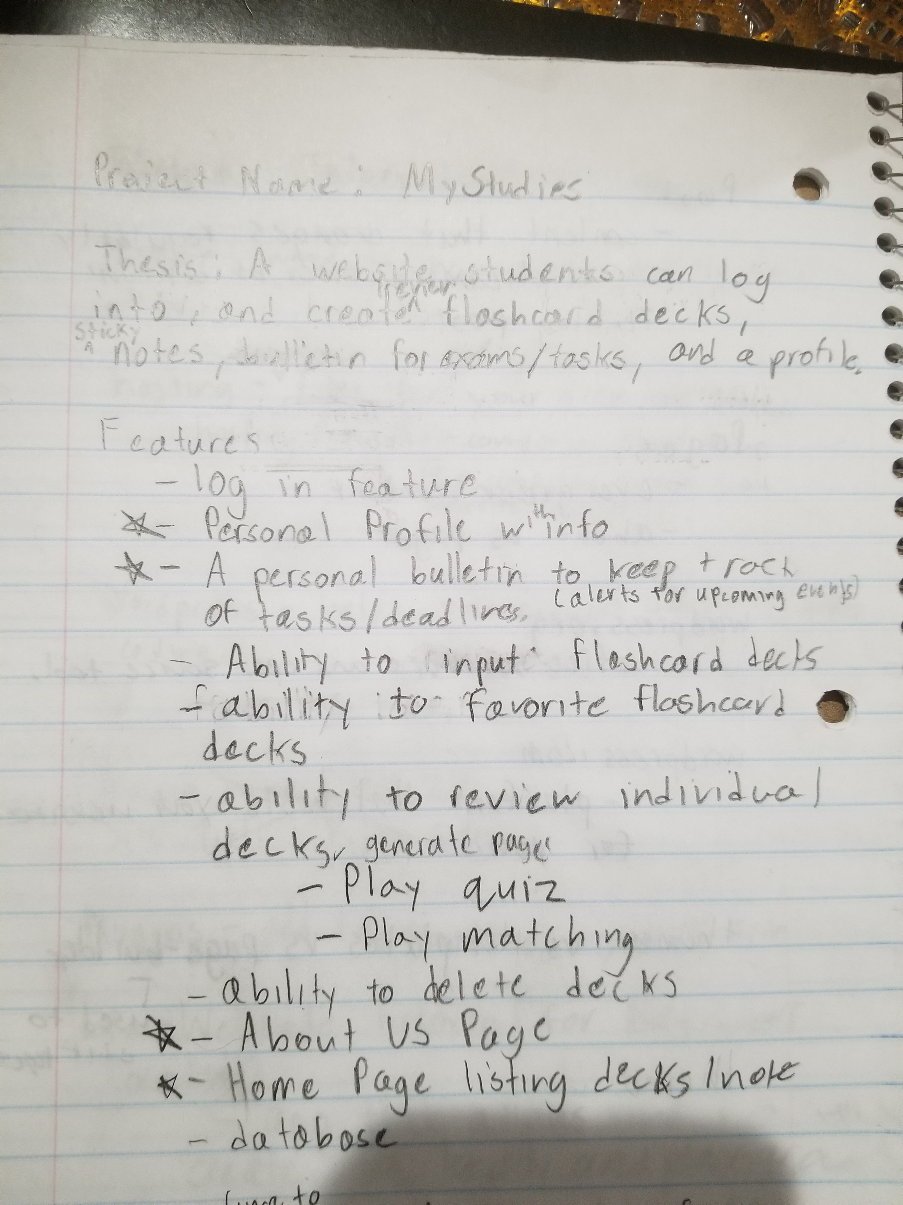
Initial Project Proposal/Brainstorm

Slide 6
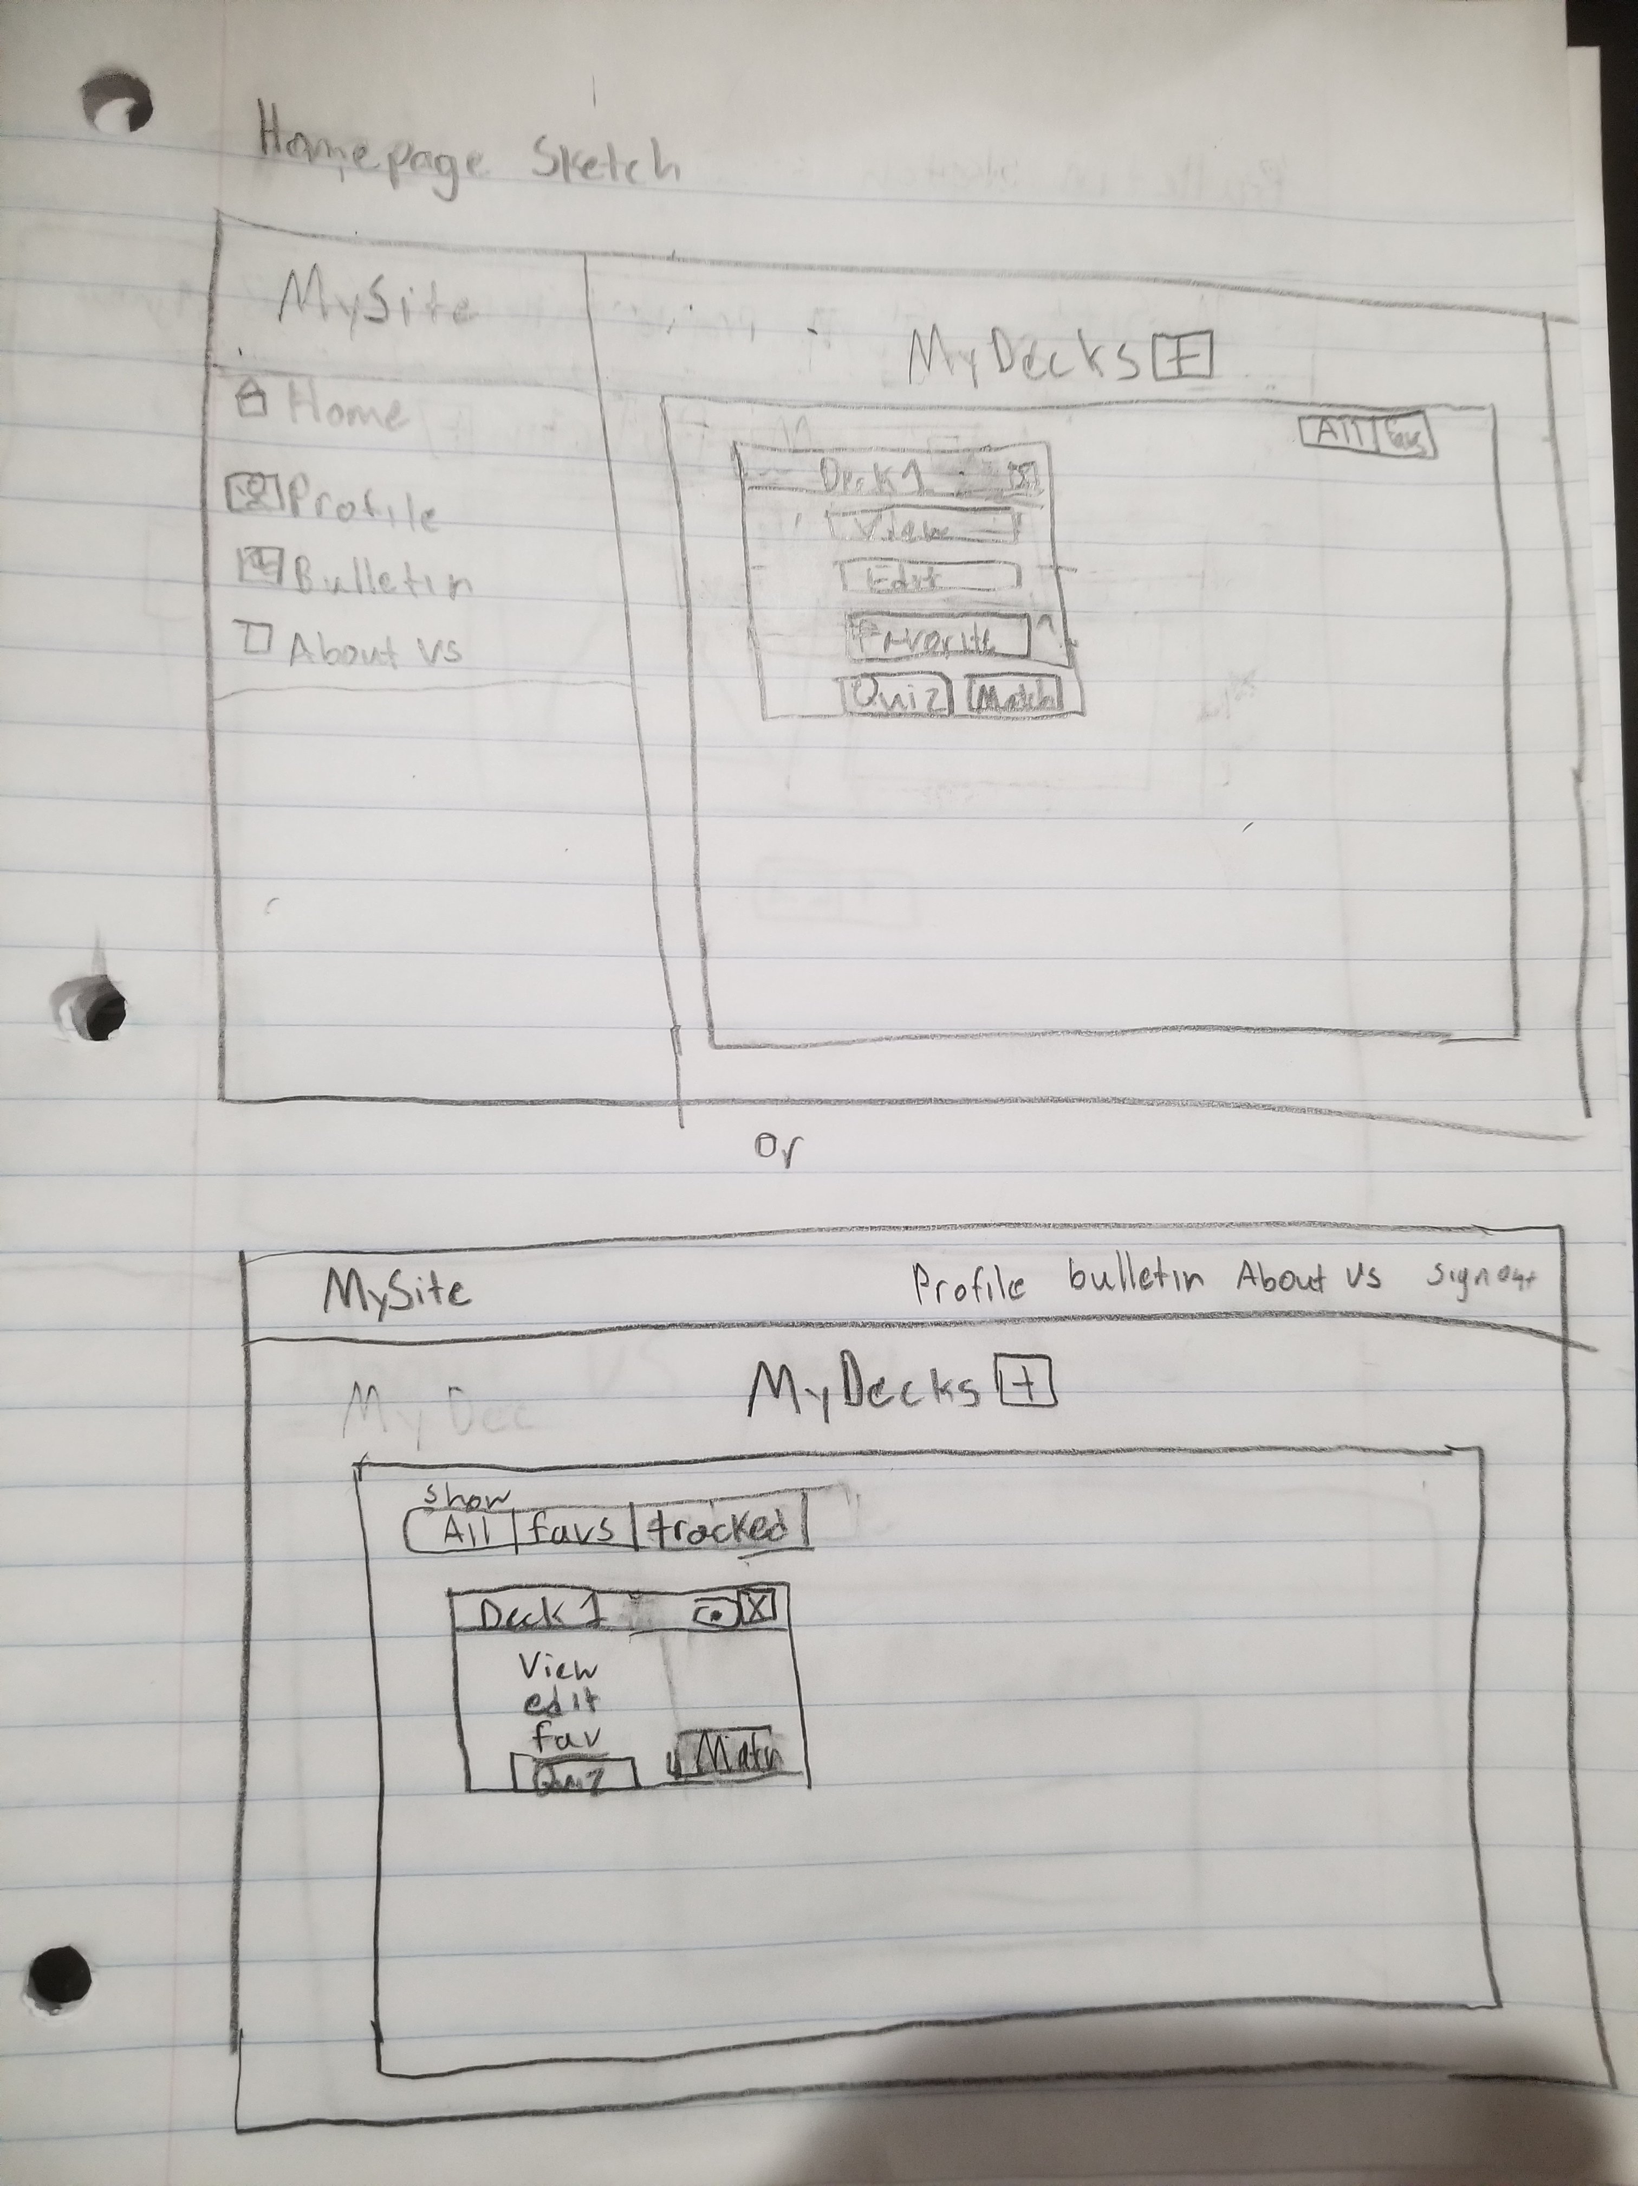
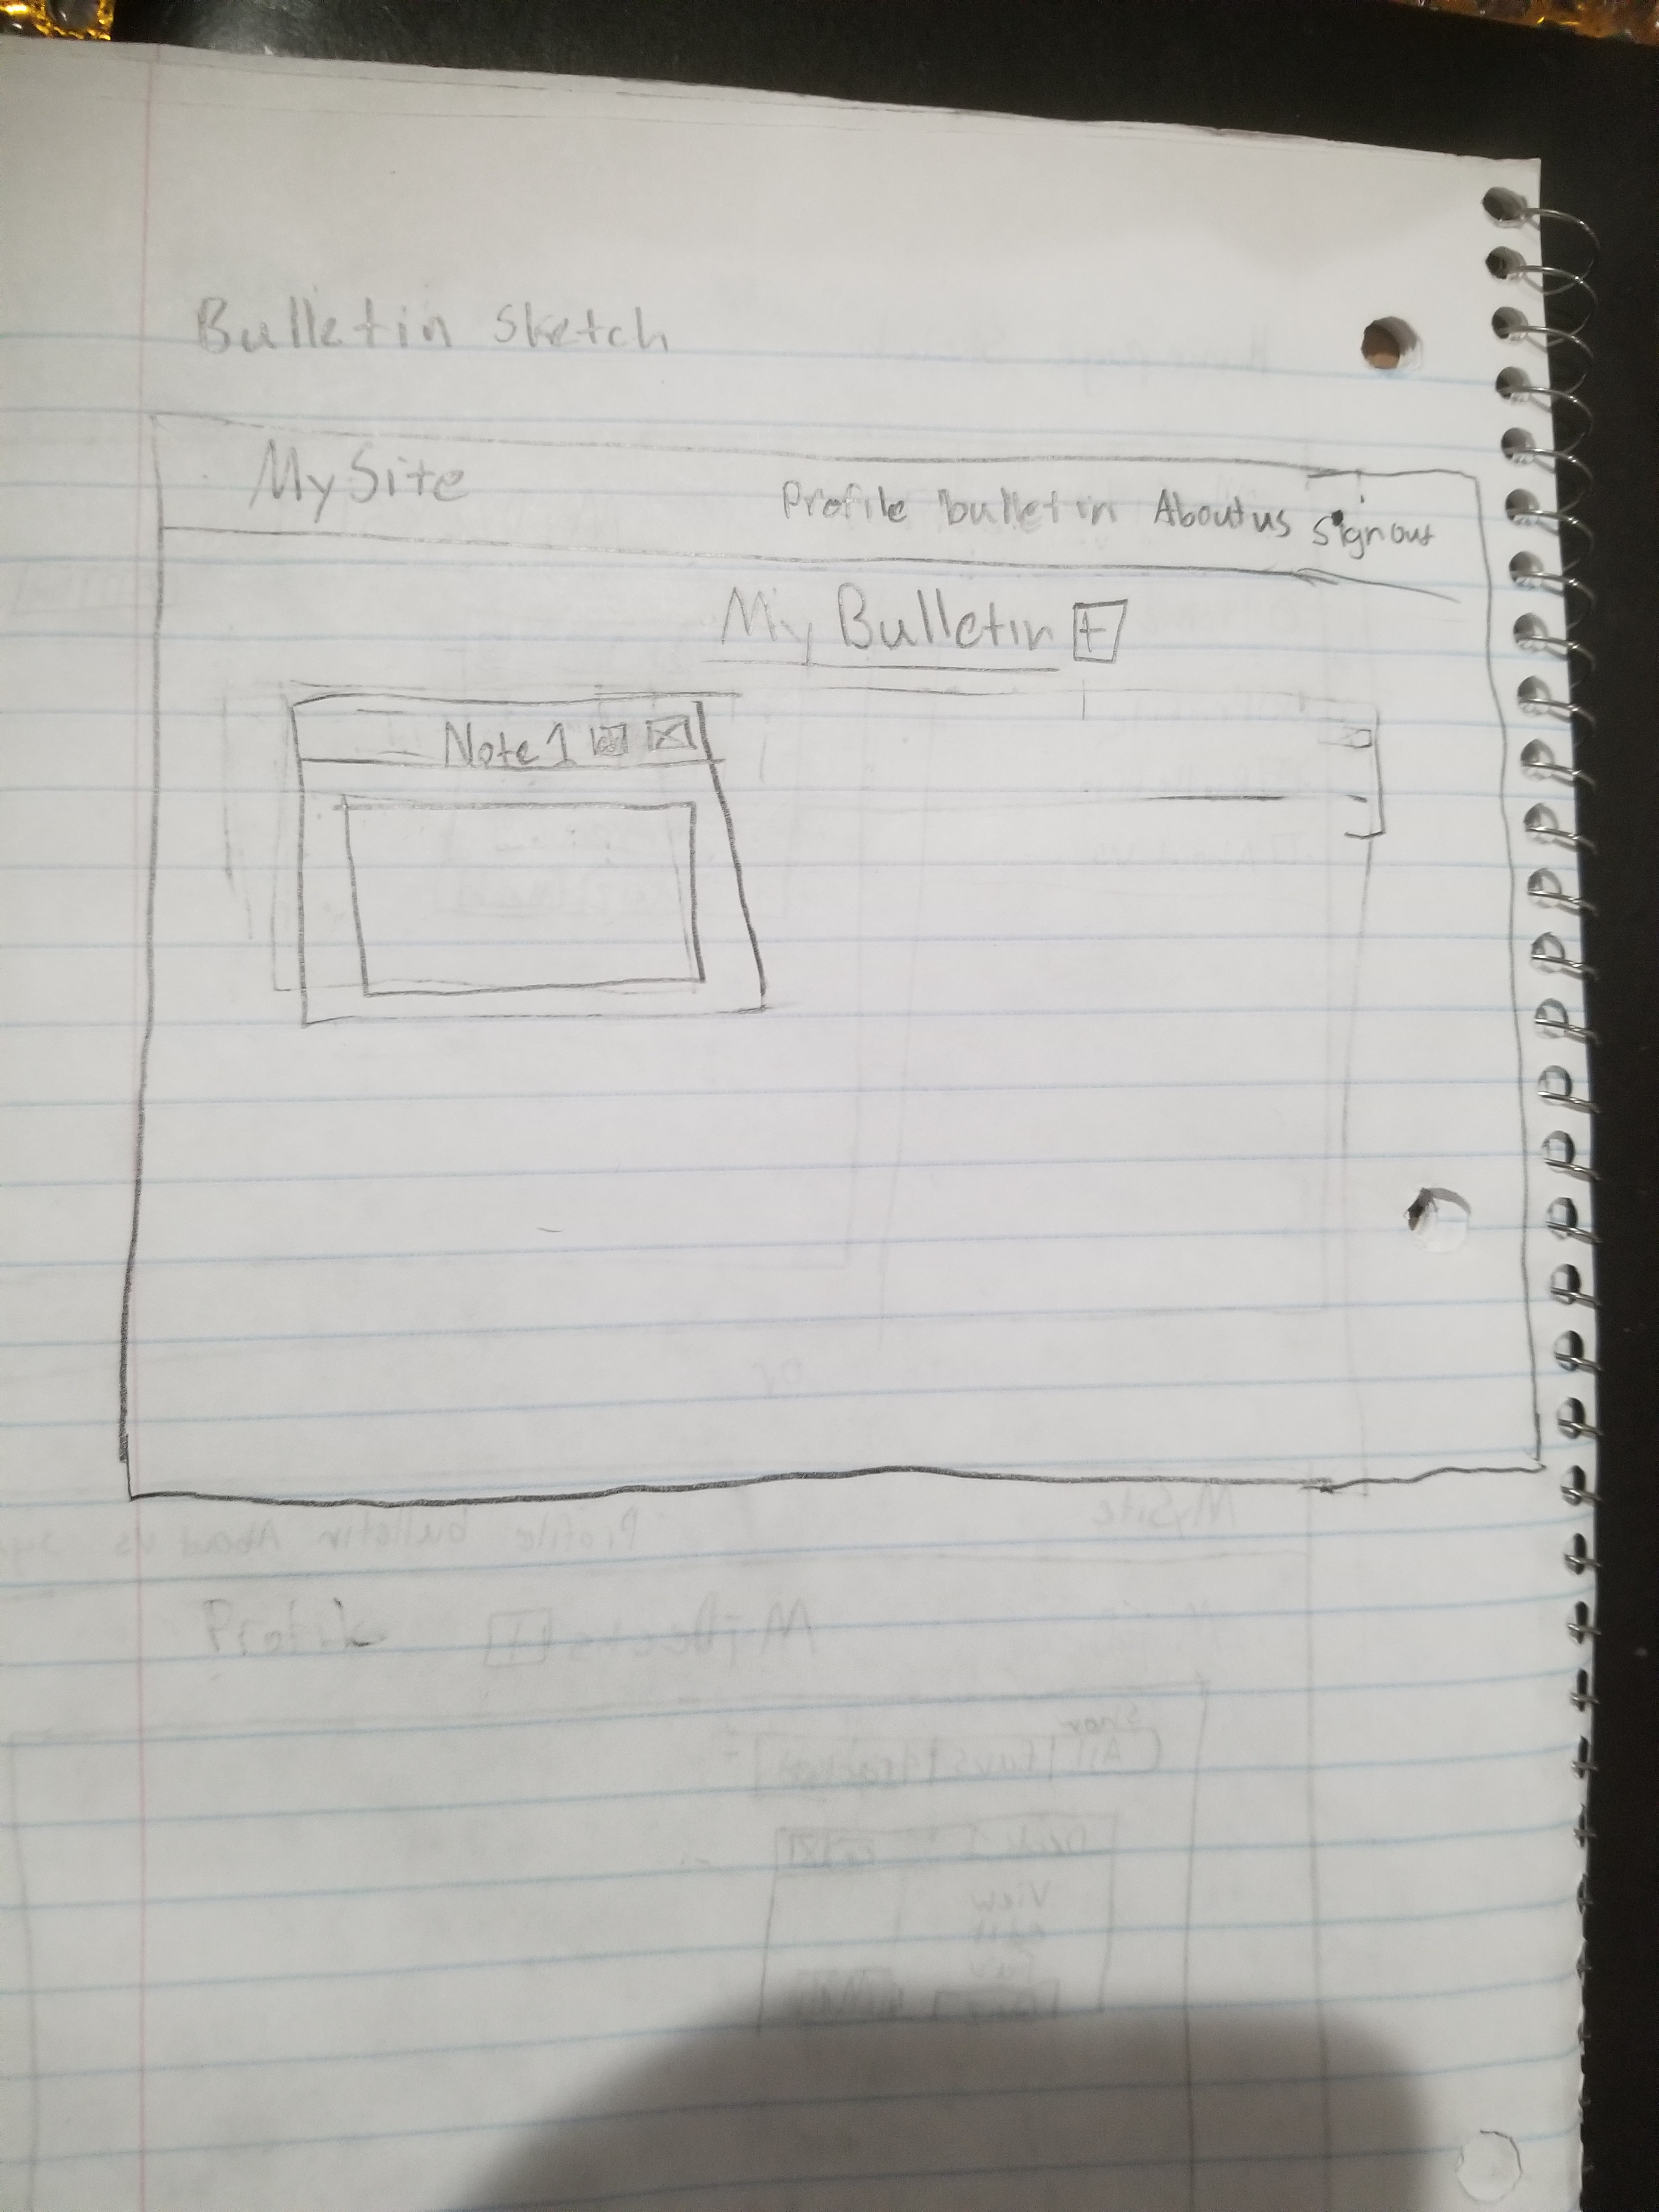
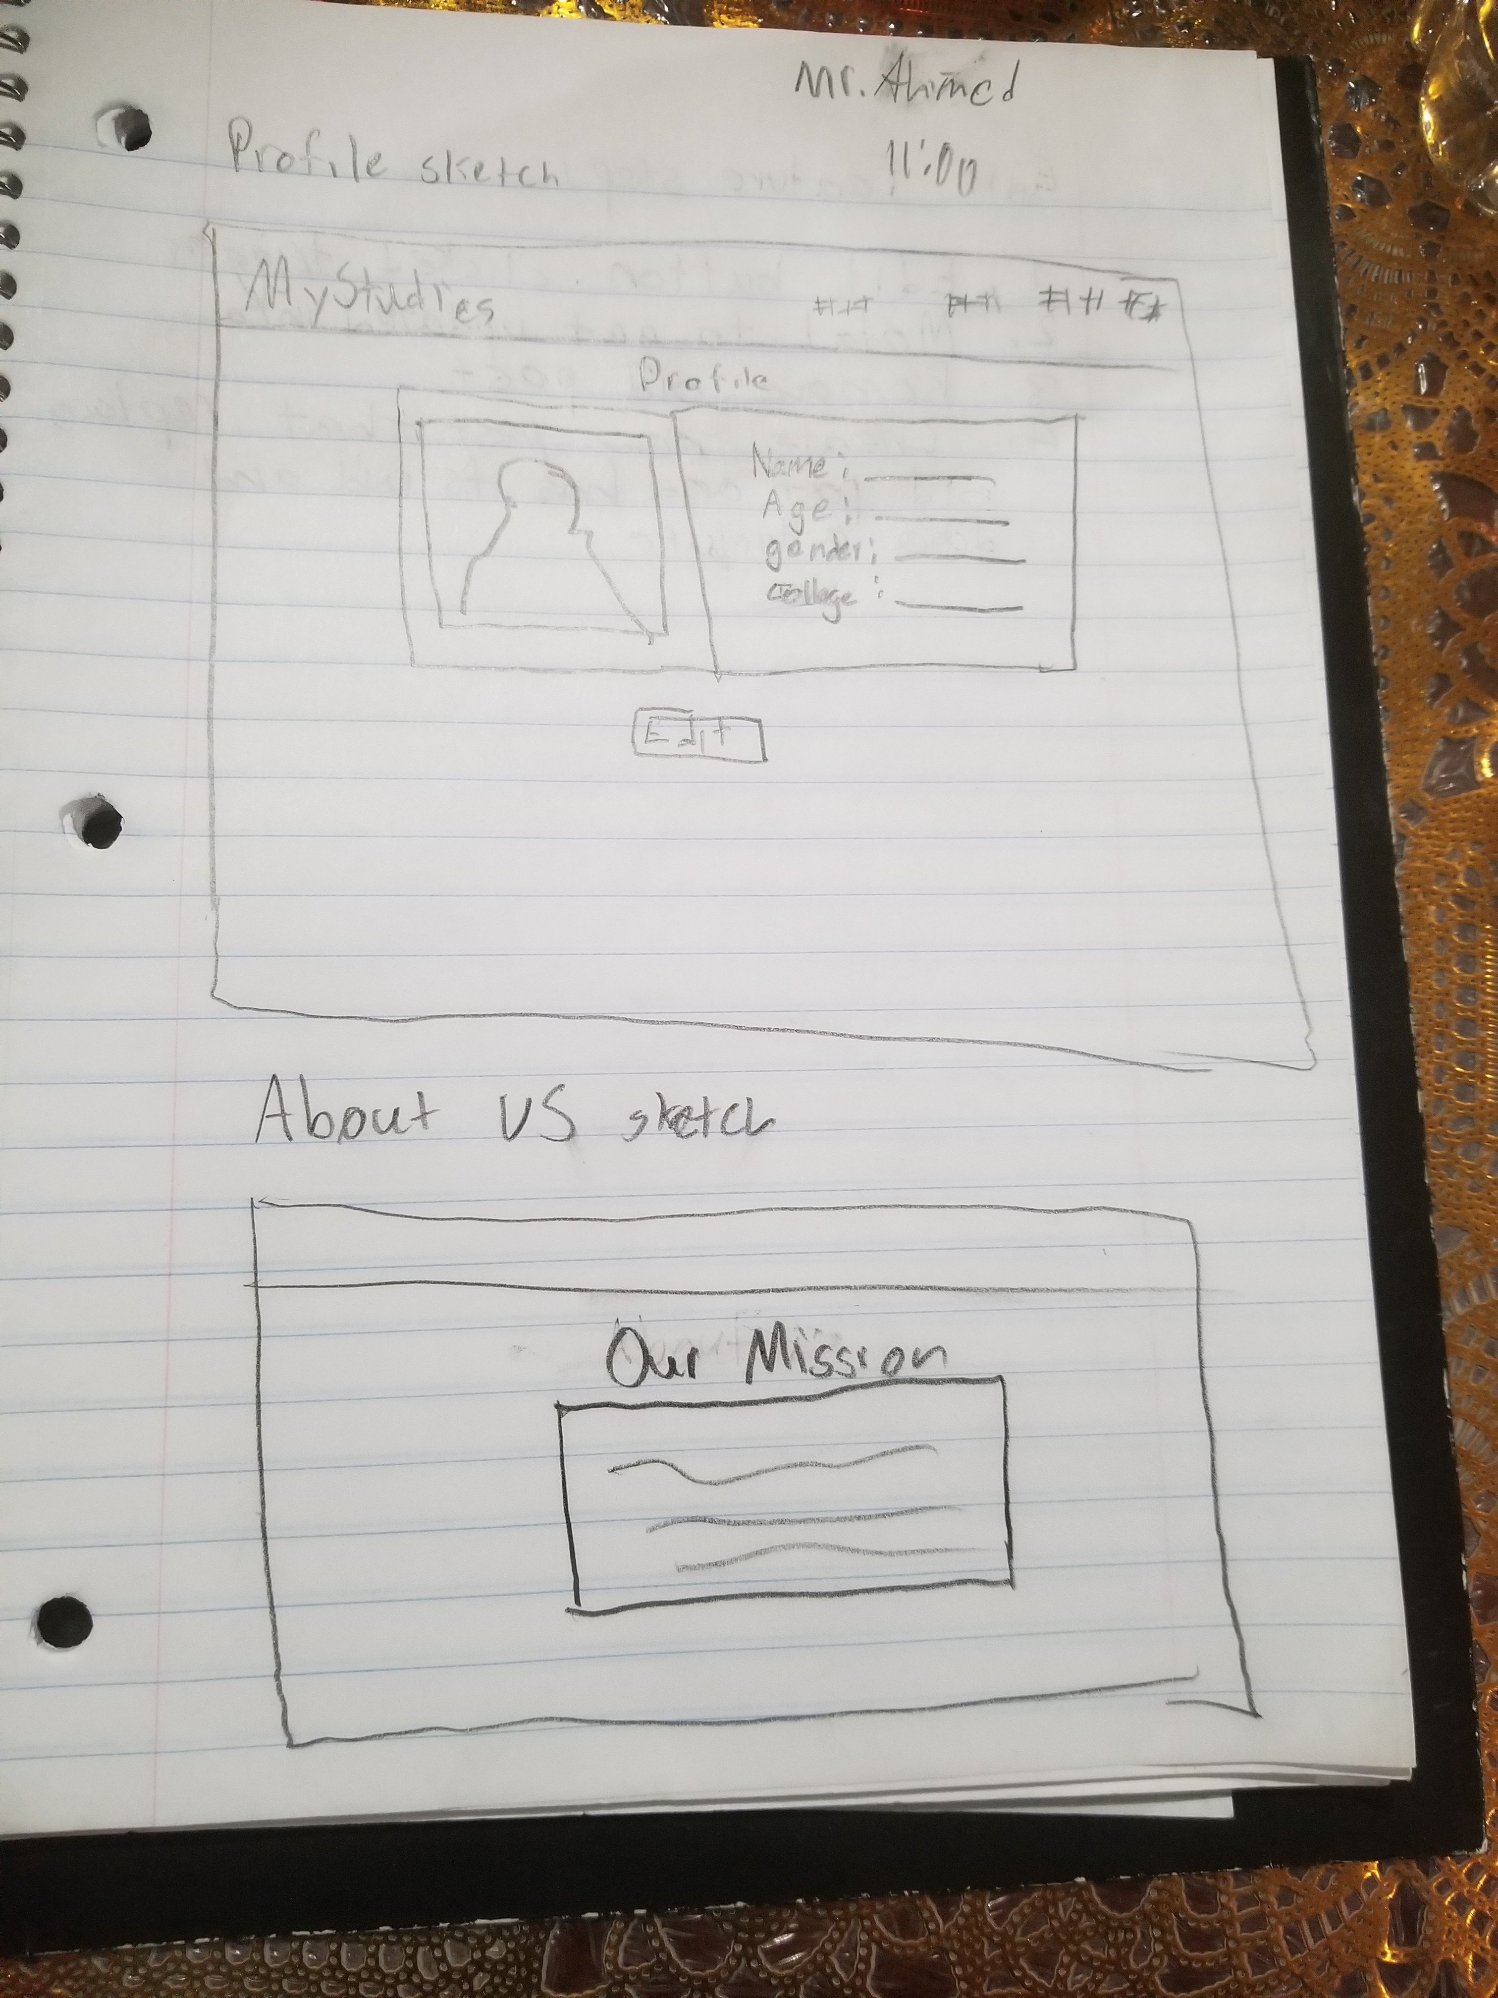
Initial Sketches

Slide 7
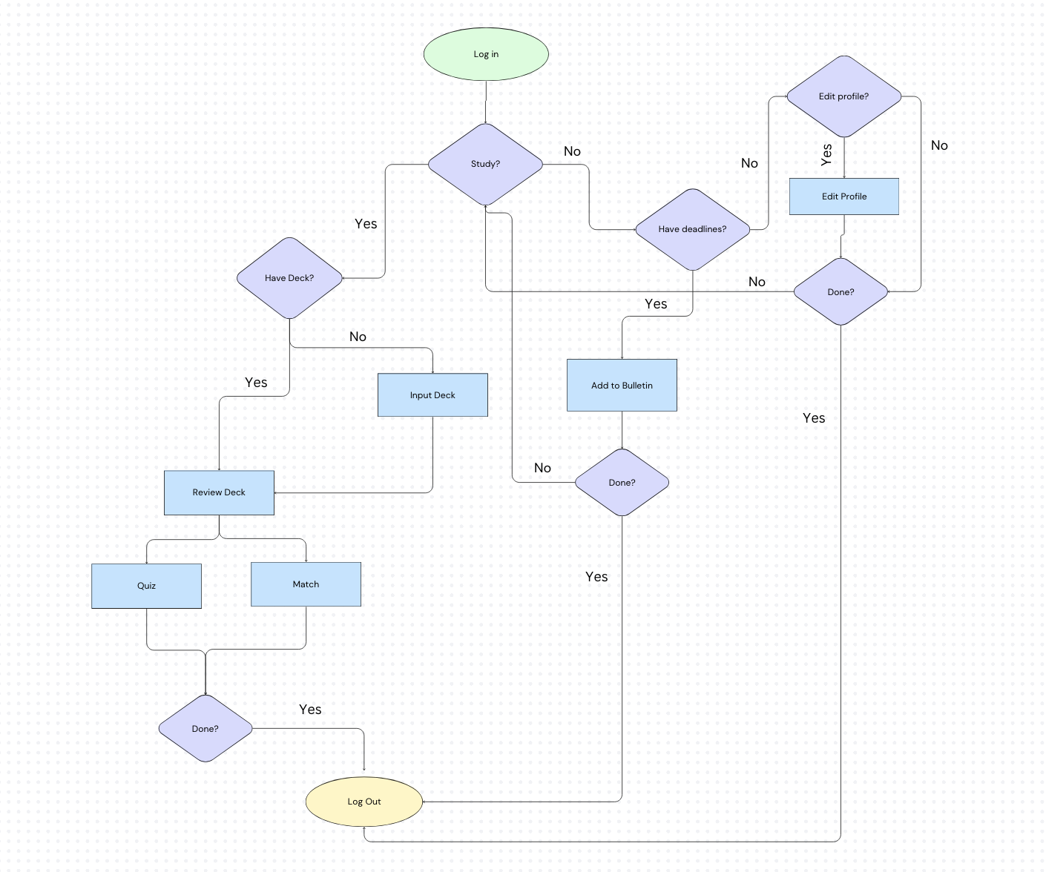
User Flow

Slide 8
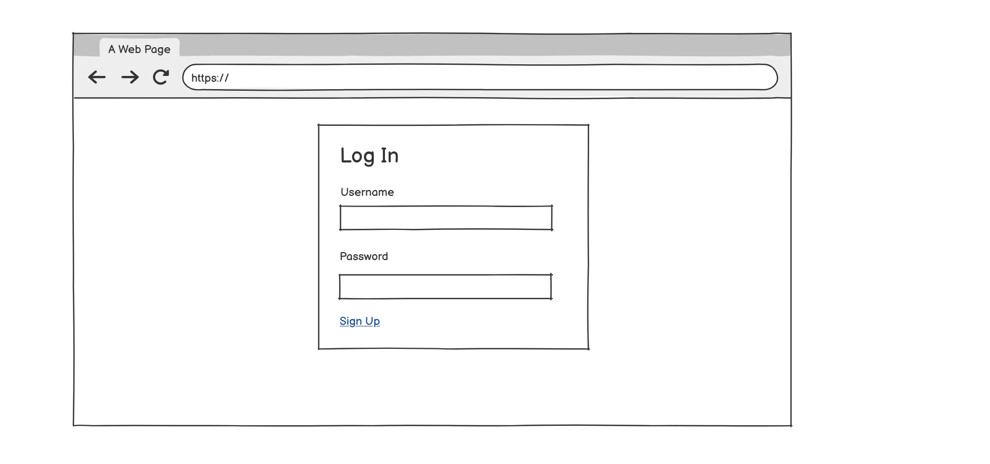
Log In Wireframe

Slide 9
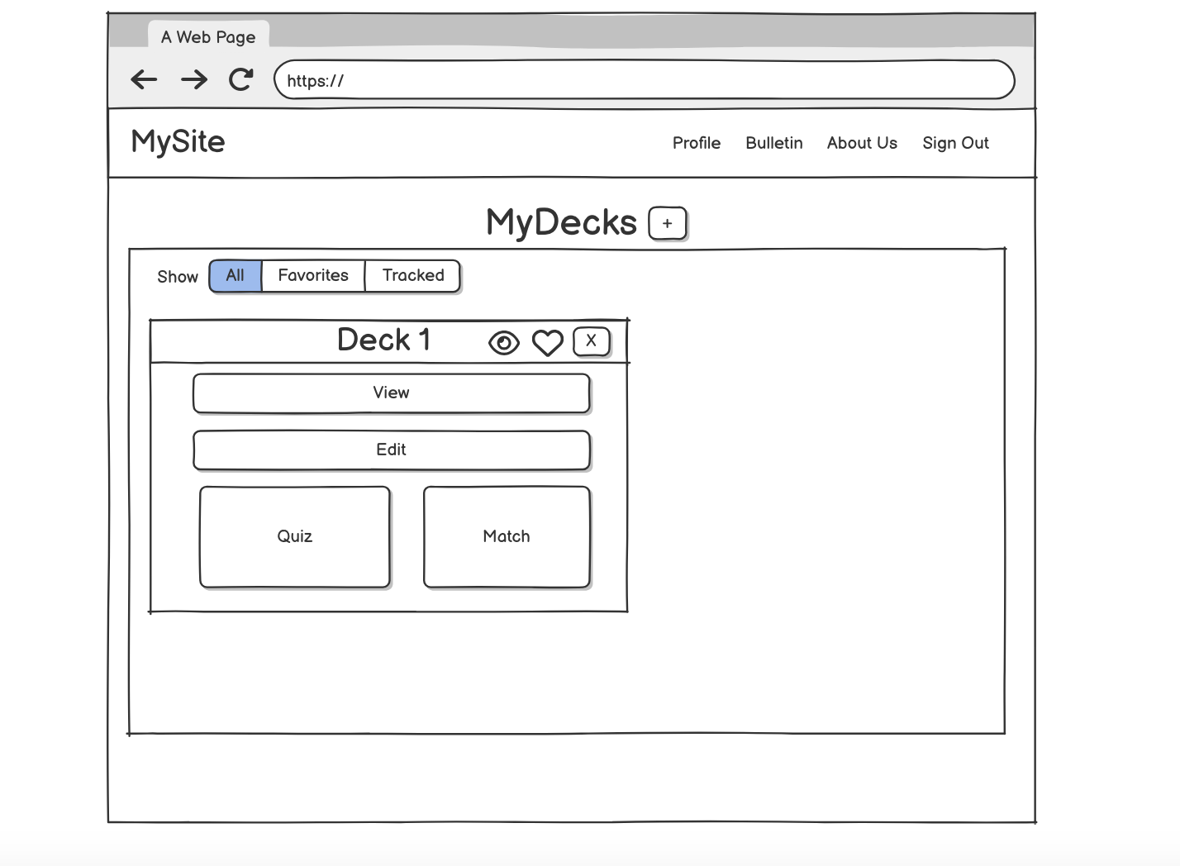
Homepage Wireframe

Slide 10
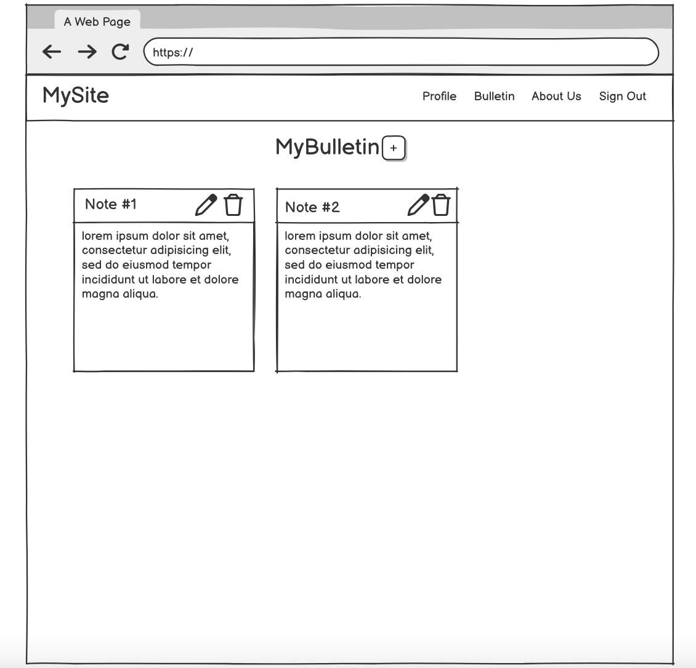
Bulletin Wireframe

Slide 11
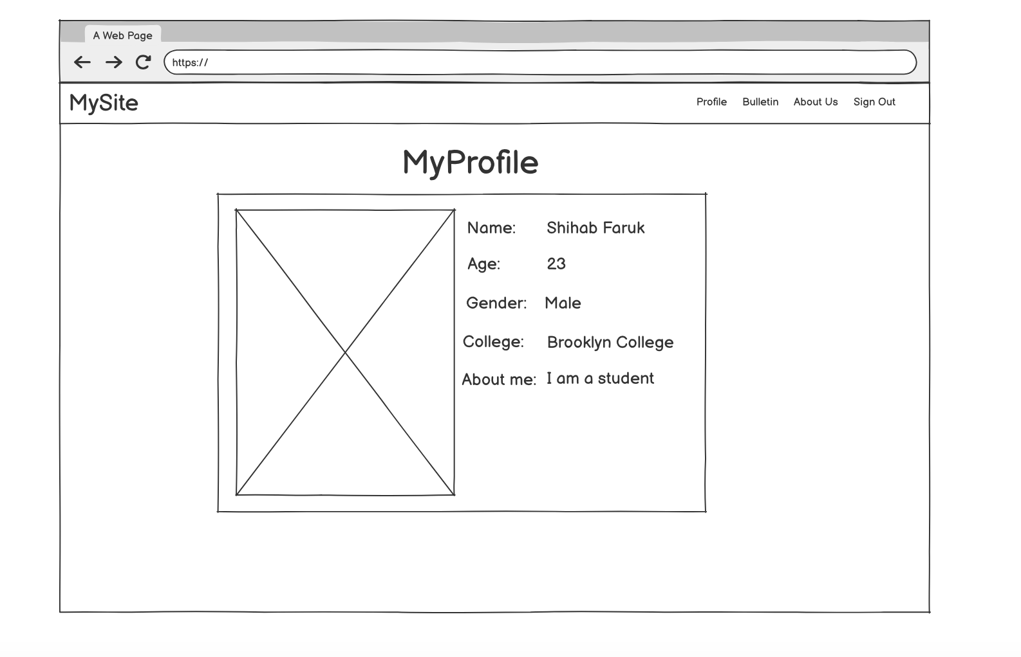
Profile Wireframe

Slide 12
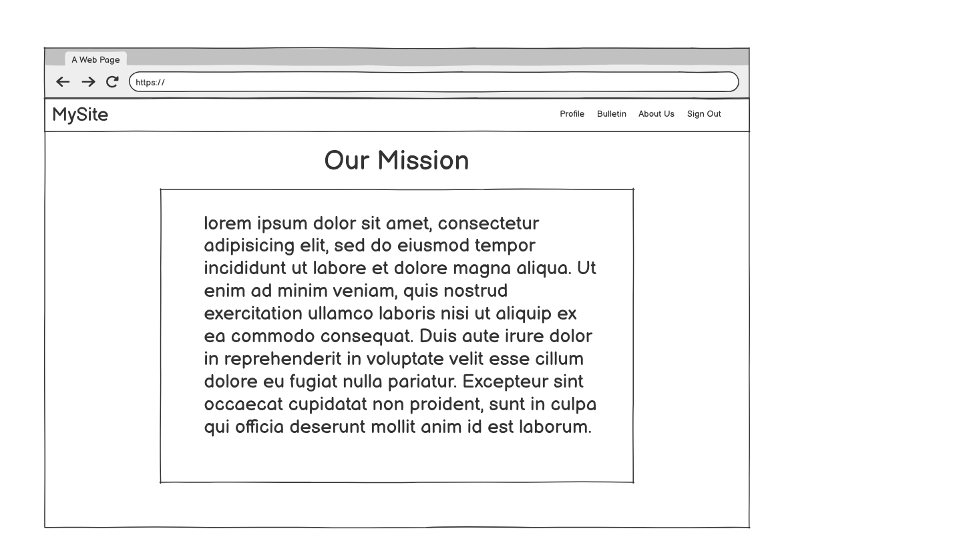
About us Wireframe

Slide 13
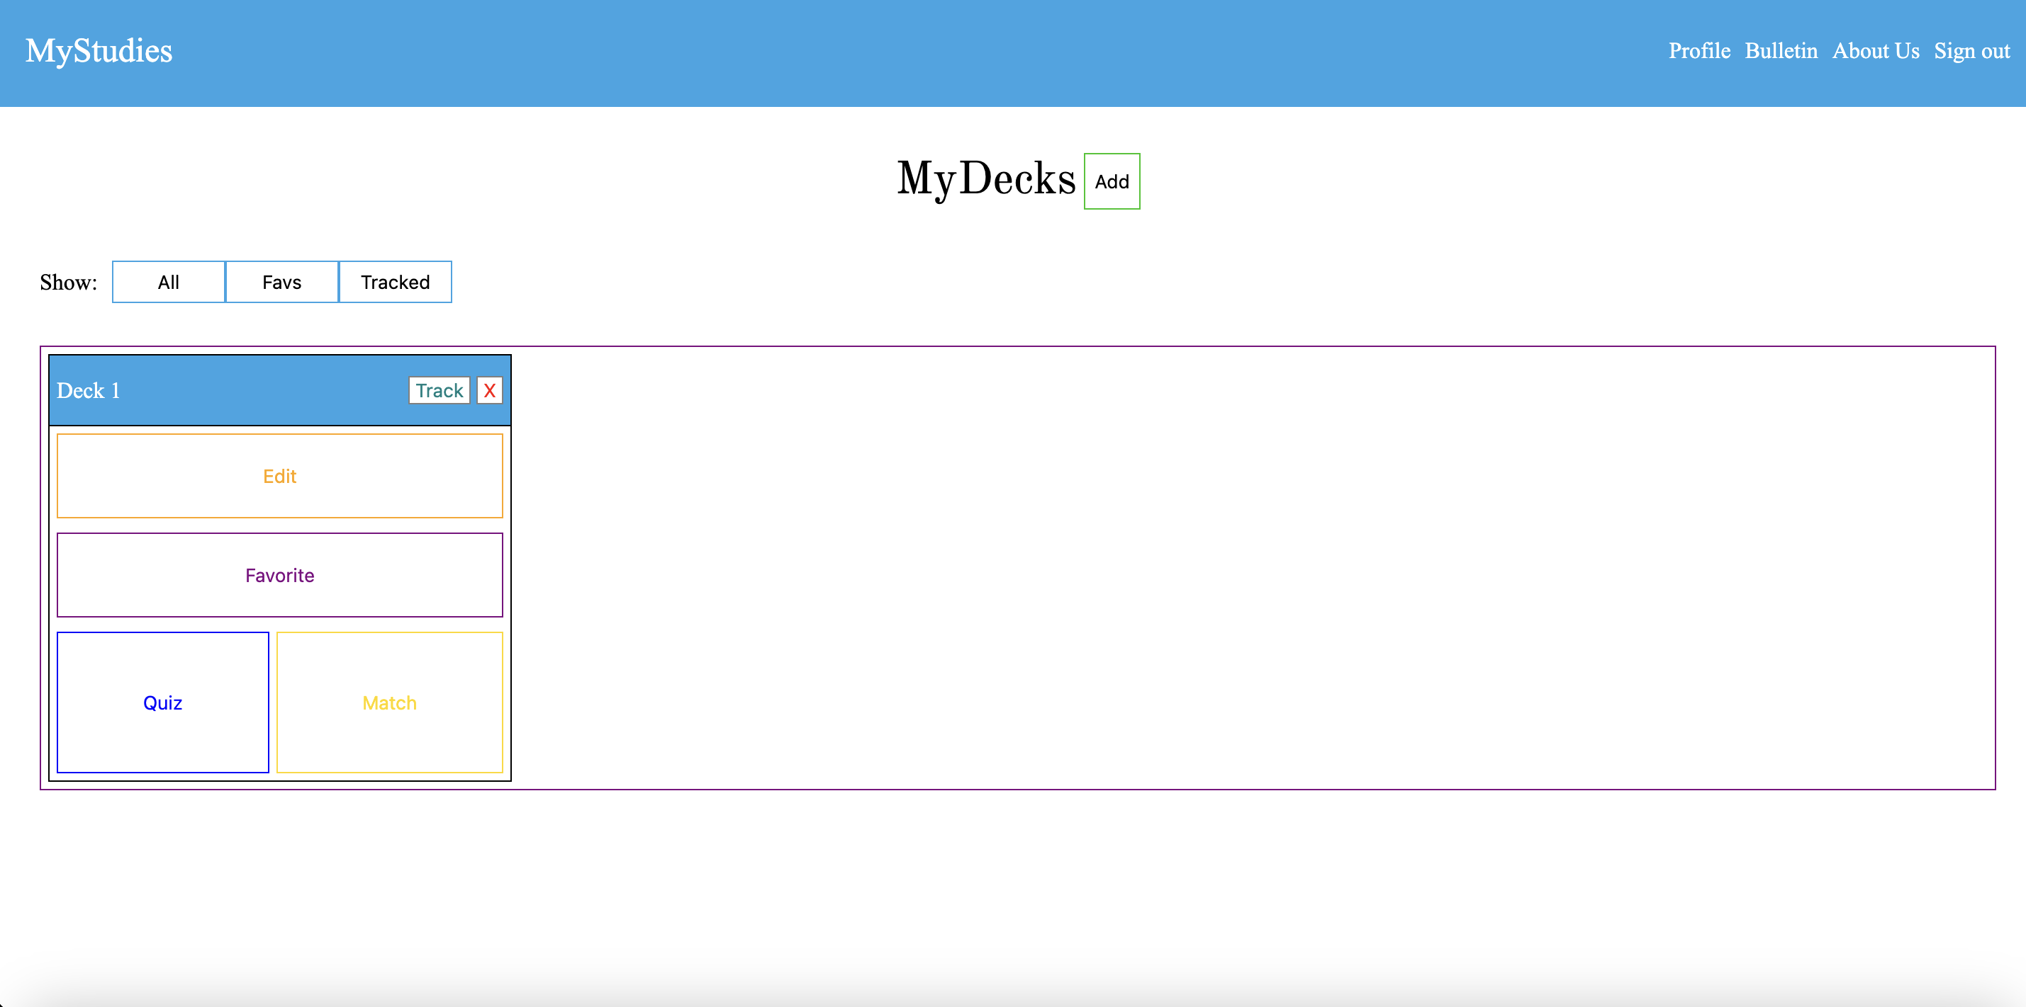
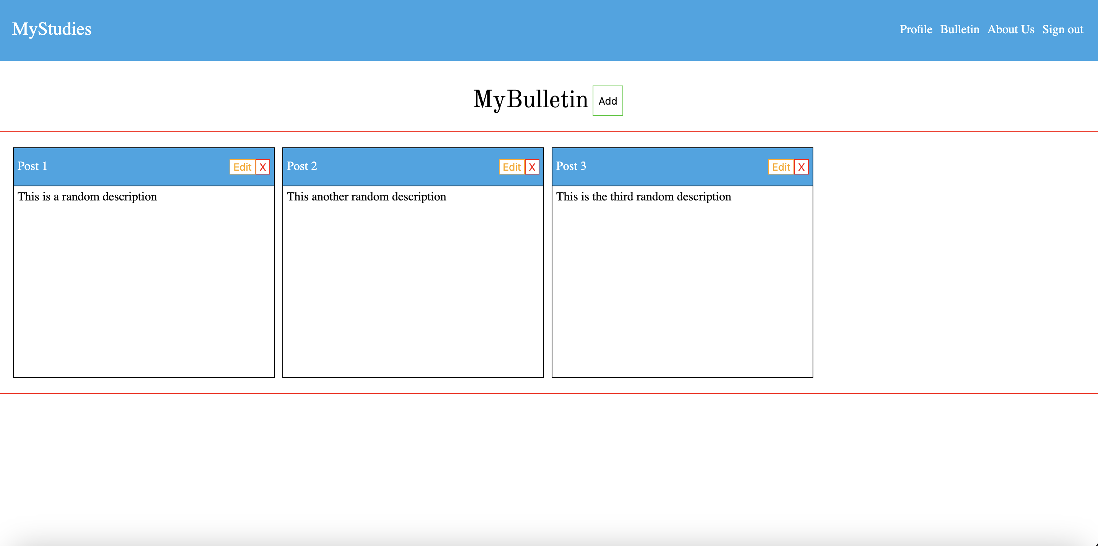
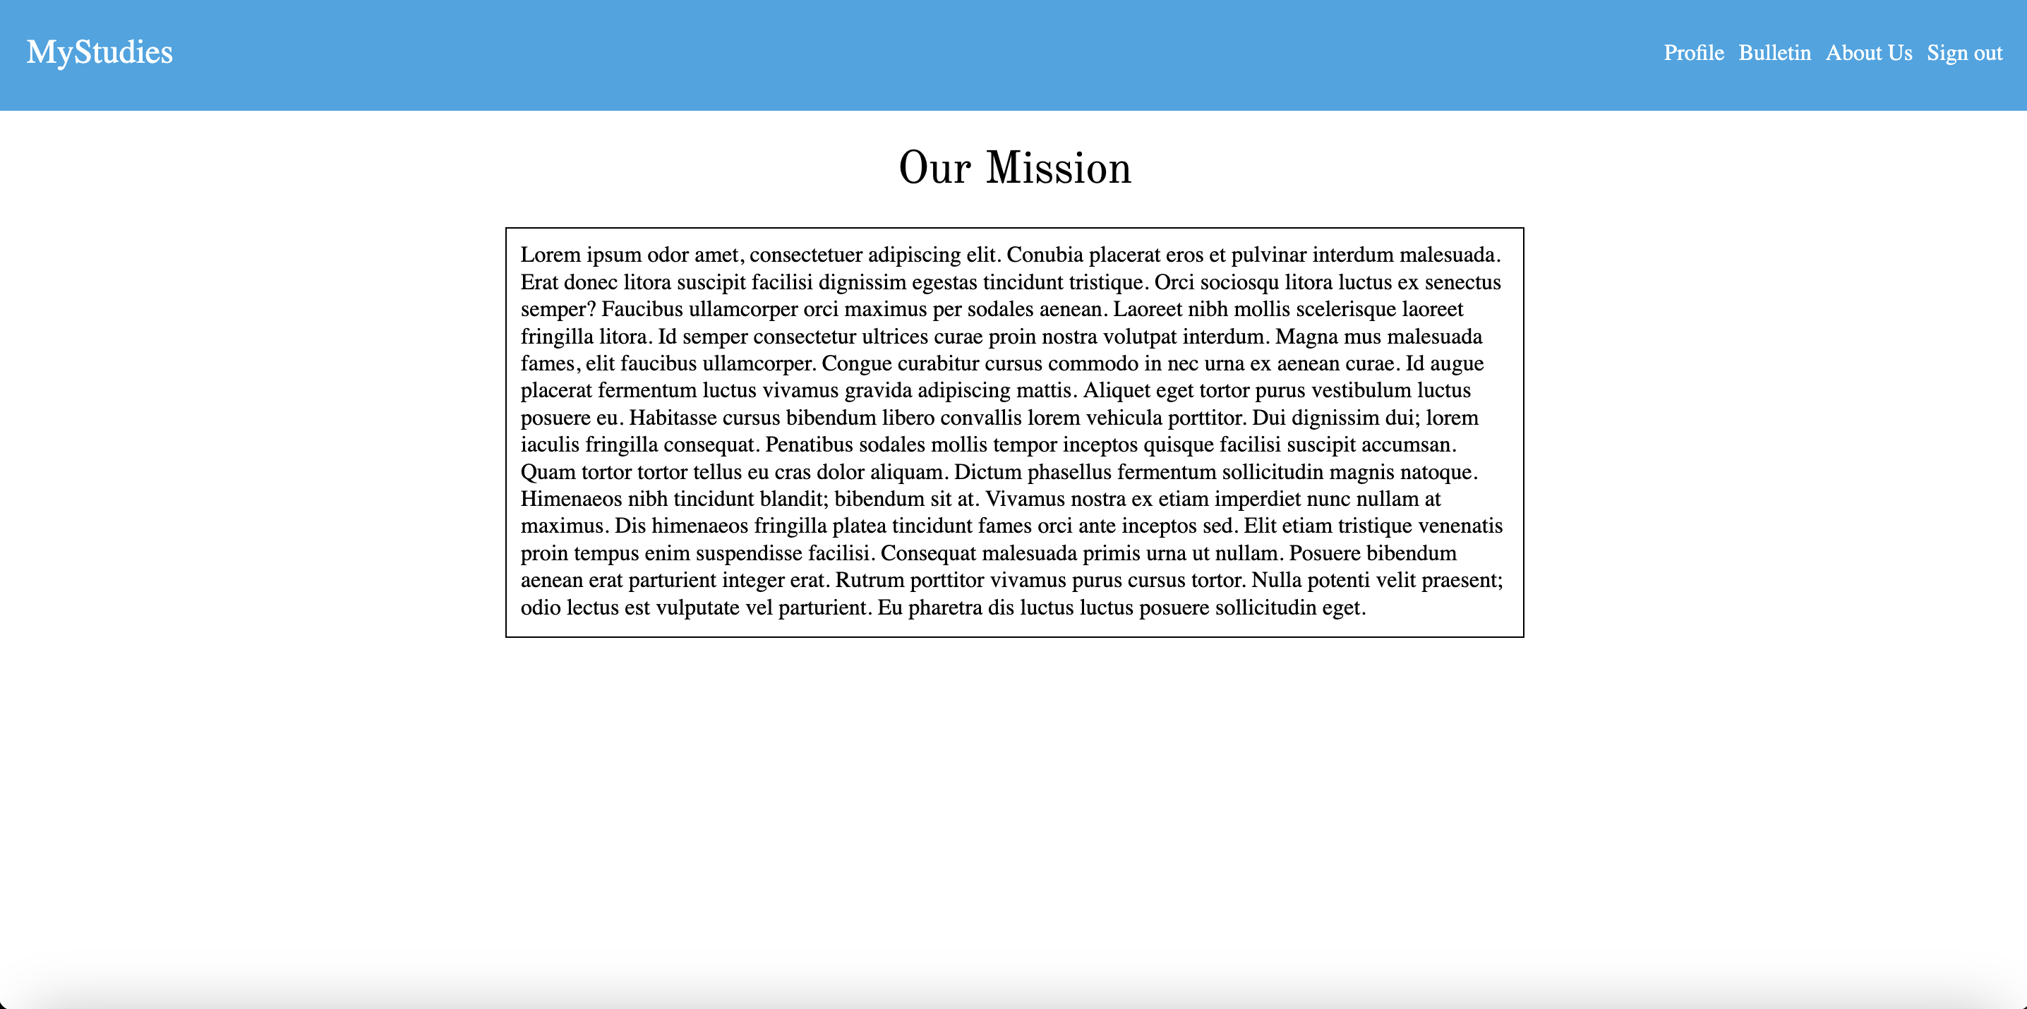
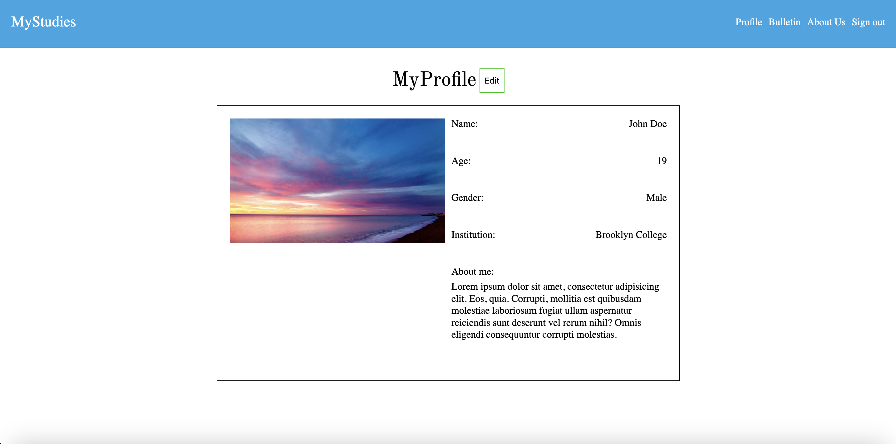
Prototype/Mockup

Slide 14
Tentative Schedule
Tasks | Timeframe
Planning the project, scope, tools, features | Weeks 1-3. This includes project proposal, project search etc.
Creating the wireframes, working on the UI of the pages. | Weeks 4-5 I will create wireframes on Balsamiq before creating pages in html and css. I will also be researching backend development during this period
Create the demo 1 showing my progress so far | Weeks 6-7
Work on creating the database schema and trying to implement it. | Weeks 7-9
Live Presentation | Week 8
Work on the Backend of the Project. | Week 9-12. This portion of the project I’m more unsure of as I’ve never worked with a backend before.
Demo 2 | Week 11.
Presentation Slides | Week 13-15

Slide 15
Updated Tentative Schedule
Tasks | Timeframe
Live Presentation | Week 8
Bulletin and Profile Functionality | Week 8
Flashdeck Implementation and Features | Week 8-10
NodeJs and Backend Research | Week 8-10
Presentation Slides | Week 10
Demo 2 | Week 11
Backend and Database Implementation | Weeks 11-14
Final Draft Presentation Slides | Weeks 13-15

Slide 16
Features (Completed and Downscoping)
I’ve almost completed the bulletin functionality. There are some bugs in terms of editing posts. However users can add and remove posts.
I’m considering removing the quiz minigame feature from flashcard decks due to possibly not having the time as I haven’t worked on flashcard deck implementation as of this date

Slide 17
What I’ve learned so far
I’ve learned about databases and how database designers use techniques such as normalization to organize data into tables.
I’ve learned how SQL is used to query a database such as MYSQL
I’ve researched how programmers interact with databases using stored procedures and orms.
I’ve learned more about the Dom as a lot of the project requires interacting with the user and that required manipulating the DOM.
I’ve also learned about designing for the user and common pitfalls of design such as only looking at the developers pov and not considering different user scenarios.

Slide 18
Will I use any Datasets?
Most likely no. Most of the data will probably be created by me and inserted into a database.
My database will store dummy users and their flashcard decks, bulletin posts, and profile information.

Slide 19
Use Case #1
Scenario 1: A student will want to review flashcards for a history exam. The student will log in with their proper credentials and in the homepage click the plus button. A modal will pop up and take in definitions and terms inputted from the user in a form. Once submitted a deck object containing the terms will appear on the homepage. The student will click the matching game in the deck container to test themselves.

Slide 20
Use Case #2
A student has to keep track of next week’s Data Structures exam, his sister’s birthday, and a networking event in 3 weeks. The student clicks on the bulletin tab at the top of the homepage. The user then clicks the plus button and through a modal creates a “sticky note”. The user does this for the other 2 events as well. The user can log in to the site and know what reminders they have set for themselves.

Slide 21
Use Case #3
A student has just taken his history final exam and got an 85. He created a deck for review a week before the exam. The student is done for the year and decides he doesn’t need his materials for the class anymore. He logs in with his credentials and at the homepage finds the deck titled History Final. He then presses the x at the top right corner of the deck deleting the flashcard deck for that class.

Slide 22
Project Repository, Board, Timelog
https://trello.com/b/5IXwlYMt/mystudies
https://github.com/sfaruk2001/MyStudies
https://docs.google.com/spreadsheets/d/1EsyQGhvC0-jWOFdOOozN6SUHjqwqnB2TzA8AkmE8NFk/edit?gid=0#gid=0

